Slide 1
AIE1903: Multimodal Agentic Assistant-Tool Use and Autonomous Systems
Lecture 1 — RGB Image, Data Normalization,
and Word Embedding
Ming Li | CUHK(SZ), SAI | Sep. 2026
From raw pixels and words to multimodal tokens

Slide 2
Learning Objectives
• Explain how an RGB image is stored as numbers and tensors.
• Distinguish data augmentation for images like resizing, cropping, padding, rescaling, and normalization.
• Explain tokenization, token IDs, and word/token embeddings.
• Describe how image patches become visual tokens.
• Describe a complete multimodal input pipeline.
Goal: understand the input, not train a large model.
2

Slide 3
The Big Picture: From Human Input to Model Input
Image/Text
Numbers
Tokens
Embeddings
Transformer
Humans directly process visual and language information via organic sensors
How does an AI model receive and perceive these?
Neural networks do not directly “see” a cat or “read” a sentence.
They receive tensors and perform numerical operations.
4

Slide 4
Roadmap
Part I — RGB Image
Part II — Data Normalization
Part III — Text and Word Embedding
Part IV — Visual Tokens and Multimodal Input
3
Notes:
[Sources]
- Course overview and instructor-provided structure.
- Educational illustrations generated for this lecture.

Slide 5
Part I — RGB Image
How does a computer represent a color image?
5

Slide 6
Digital Images Are Grids of Pixels
• Pixel = image element = colors + spatial locations.
• A grayscale pixel stores one intensity value.
• A color pixel usually stores three channel values.
R: 235
G: 66
B: 54
240
190
45
48
150
70
45
110
220
125
65
180
240
240
240
25
25
25
130
130
130
255
255
255
3 x 3
An image is a structured array—not an indivisible object.
6

Slide 7
RGB: Red, Green, and Blue
Red
Green
Blue
(255, 0, 0)
(0, 255, 0)
(0, 0, 255)
White
Yellow
Black
(255, 255, 255)
(255, 220, 0)
(0, 0, 0)
Each pixel = (R, G, B) on a spatial coordinate, usually with values from 0 to 255.
7

Slide 8

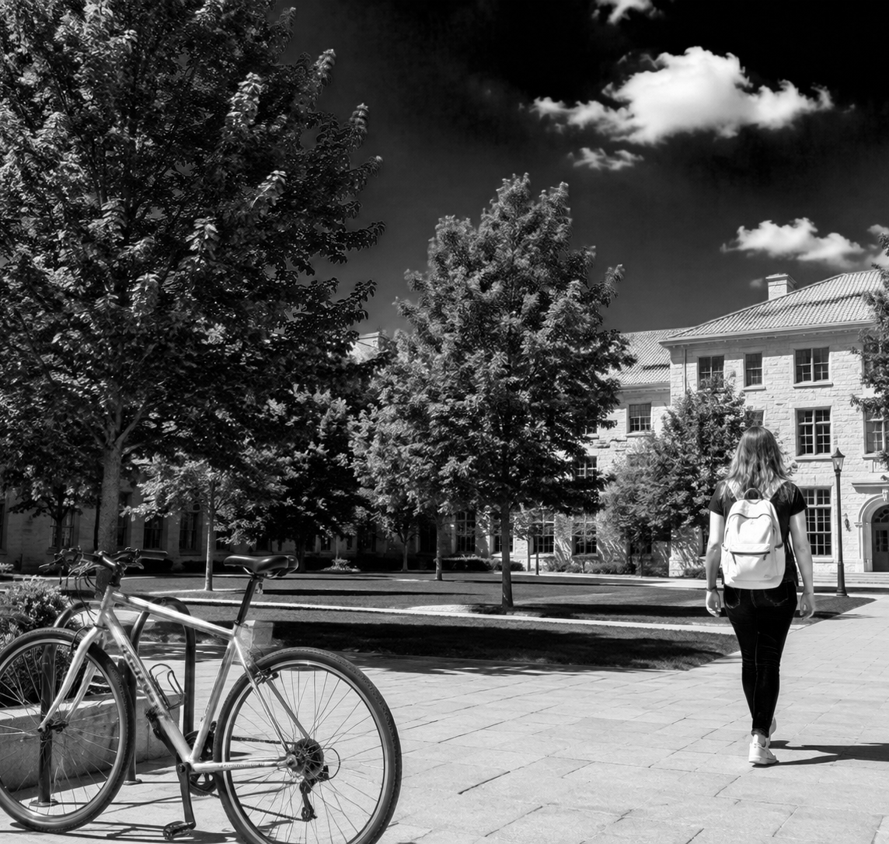
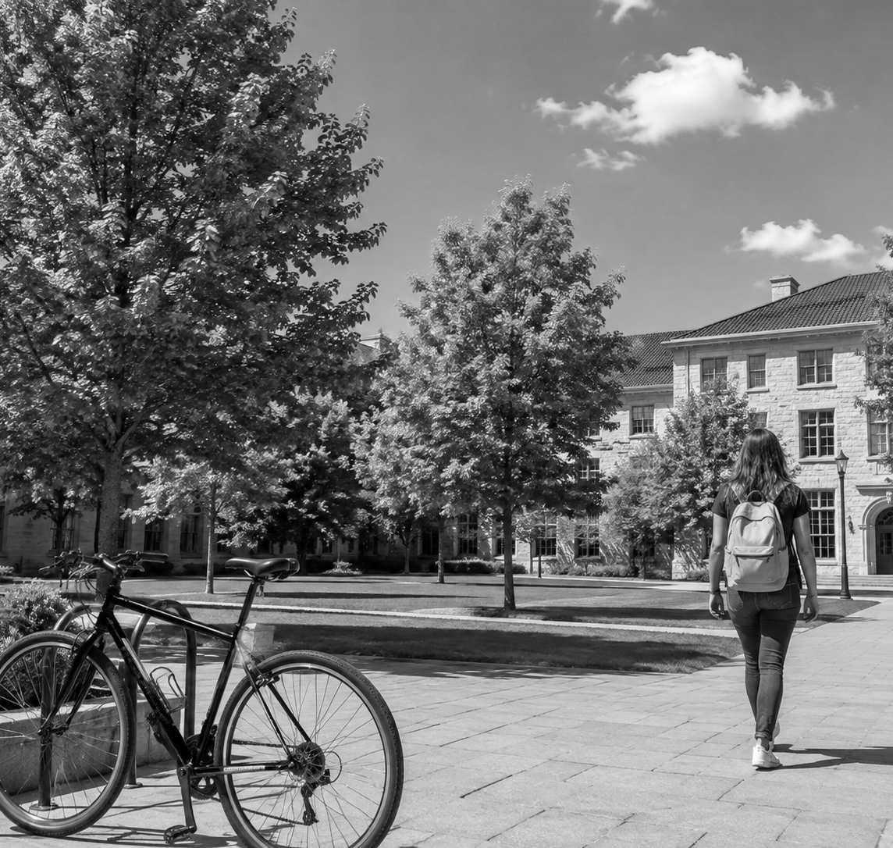
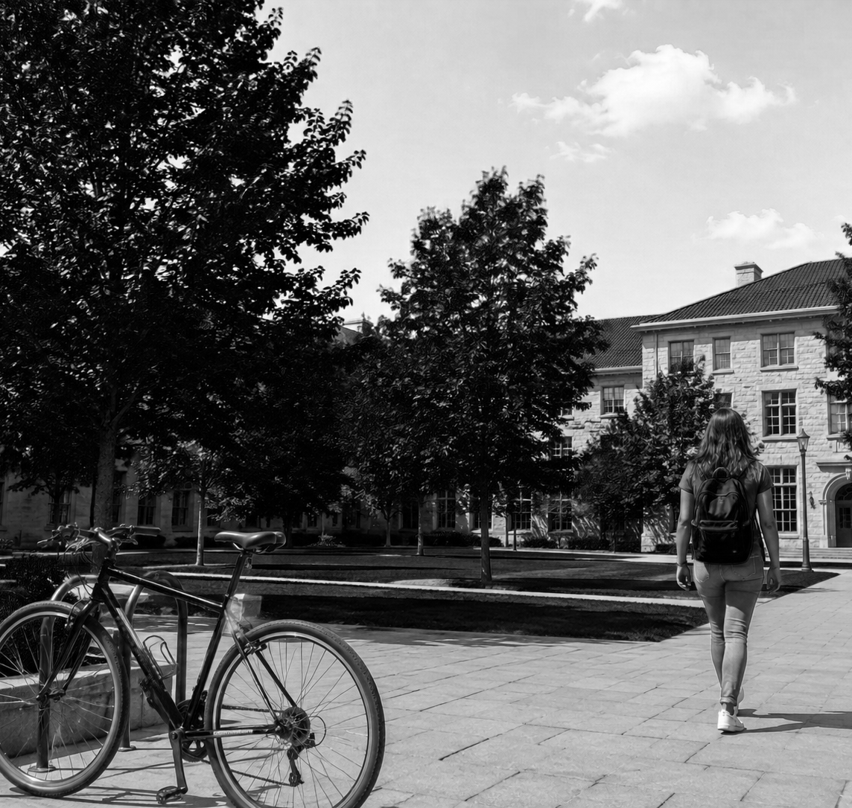
One Image, Three Color Channels
RGB image
Red channel
Green channel
Blue channel
A bright region in one channel means that color contributes strongly at that location.
8

Slide 9
Image Shape: H × W × C
• H: image height
• W: image width
• C: number of channels
• RGB images normally have C = 3
I ∈ ℝᴴˣᵂˣ³
3 stacked matrices
C does not always equels to 3 for images like multispectral images
9

Slide 10
HWC, CHW, and Batch Dimension
Image file / NumPy
H × W × C
224 × 224 × 3
PyTorch tensor
C × H × W
3 × 224 × 224
Batch of 32
B × C × H × W
32 × 3 × 224 × 224
Common bug: the values are correct, but the dimensions are in the wrong order.
10

Slide 11
Resolution Controls Detail and Cost
224 × 224
448 × 448
2× width and height
50,176 pixels
200,704 pixels
4× pixels
• Higher resolution preserves small objects and text.
• It also increases memory, visual tokens, and computation.
• Input resolution is therefore a design trade-off.
11

Slide 12
Image File ≠ Image Tensor
JPEG / PNG
Decode
RGB pixels
Tensor
• Stored Image files (.jpg/png) contain compression information and file metadata.
• Decoding algorithms reconstruct pixel values. (We do not care about it)
• Convert grayscale or RGB images to the expected RGB format.
• Check shape, channel order, data type, and value range. (Caution for debugging)
12

Slide 13
Roadmap
Part I — RGB Image
Part II — Data Normalization
Part III — Text and Word Embedding
Part IV — Visual Tokens and Multimodal Input
13
Notes:
[Sources]
- Course overview and instructor-provided structure.
- Educational illustrations generated for this lecture.

Slide 14
Part II — Data Normalization
Why do models transform pixel values before using them?
14

Slide 15
A Typical Image Preprocessing Pipeline
Decode
RGB
Resize
Crop / Pad
Rescale
Normalize
• The processor makes various real-world images compatible with a fixed model interface.
• The inference pipeline should match the preprocessing used during pretraining!!!
Preprocessing changes what information reaches the model.
16

Slide 16
Common Operations w.r.t Inputs
Data Augmentation
Before the tensor converting
image
Input normalization
Before the model
Pixels
Batch normalization
Inside a network
Batch features
Layer normalization
Inside a Transformer
Token features
15

Slide 17
Resize, Crop, and Padding
Why Is Data Augmentation Necessary?
Increase Data Diversity
Reduce Overfitting
Resize
Crop
Padding
Changes spatial dimensions
Keeps selected region
Adds border area
May distort aspect ratio
May remove edge objects
Preserves full content
17

Slide 18
Rescaling Pixel Values to [0, 1]
0
→
0.000
x' = x / 255
64
→
0.251
128
→
0.502
How to reach [-1, 1]?
x = (x-255/2)
x' = x / (255/2)
192
→
0.753
255
→
1.000
Rescaling only changes the numerical scale, not the image meaning.
18

Slide 19
Mean–Standard Deviation Normalization
x' = (x − μ) / σ
• Subtract μ: center the data around the mean.
• Divide by σ: express values relative to variation.
• RGB channels usually use separate μ and σ values.
• Negative outputs and values above 1 are normal.
Example
x = 0.80, μ = 0.50, σ = 0.25
x′ = 1.20
19

Slide 20
Worked Example: Normalize One RGB Pixel
Original pixel: (128, 64, 255)
Divide by 255
(0.502, 0.251, 1.000)
Subtract μ = 0.5
Divide by σ = 0.25
Normalized result ≈ (0.008, −0.996, 2.000)
• Each channel is processed independently.
• The output does not need to stay between 0 and 1.
20

Slide 21
Why Normalization Matters
01
Avoid unnecessarily large input values
Stable scale
02
Reduce differences in channel statistics
Comparable channels
03
Keep inference inputs in the expected distribution
Match pretraining
04
Keep the same scale for different data sources
Unifying data scales
The most important practical rule: use the processor released with the pretrained model.
21

Slide 22
Common Image Input Failures
RGB ↔ BGR
Wrong color channel order
Wrong range
0–255 used without normalization
Wrong crop
Exclude important objects
Low resolution
Small objects are not identifiable
Wrong shape
Wrong dimension order: HWC or CHW?
A model error may begin before the model itself.
22

Slide 23
Roadmap
Part I — RGB Image
Part II — Data Normalization
Part III — Text and Word Embedding
Part IV — Visual Tokens and Multimodal Input
23
Notes:
[Sources]
- Course overview and instructor-provided structure.
- Educational illustrations generated for this lecture.

Slide 24
Part III — Text and Word Embedding
How does a sentence become a sequence of vectors?
24

Slide 25
Text Processing Pipeline
Raw sentence
Tokenizer
Tokens
Token IDs
“A student is reading a book.”
[A] [student] [is] [read] [ing] [a] [book] [.]
• A token may be a word, subword, character, punctuation mark, or special symbol.
• Tokenization and embedding are two different steps.
25

Slide 26
Why Use Subword Tokens?
Whole words
Huge vocabulary = huge token size
Unknown names and new terms are not supported !
Characters
A word = long token sequences
Weak token-wise semantics
Subwords
Reusable pieces balance vocabulary size and sequence length/semantics
Example: playing → play + ing
26

Slide 27
Vocabulary and Token IDs
Token
ID
<bos>
1
A
37
student
526
reading
1042
book
928
IDs are addresses in a predefined token vocabulary—not semantic significance.
27

Slide 28
Token Embedding: Look up an ID from a Matrix
Token ID 526
Embedding matrix E
Vector e₅₂₆
E ∈ ℝⱽˣᴰ
student → [0.21, −0.47, 0.83, …]
• V: vocabulary size
• D: embedding dimension
• The embedding values are learned from data.
28

Slide 29
Why not One-Hot Vector
One-hot
Dense embedding
[0, 1, 0, 0, 0, 0, …]
[0.70, −0.20, 0.40, …]
• Small representative capacity
• Very high-dimensional vectors
• Sparse and discrete
• No natural semantic similarity (cosine similarity scores of vectors are all zeros)
• Large representative capacity
• Flexibly low dimensional (>=2) vectors
• Continuous vector
• Learned during training
• Meaningful token-wise relationships
Dense embedding converts a discrete symbol into a point in a continuous feature space.
29

Slide 30
Semantic Similarity in Embedding Space
car
cat
dog
bus
tiger
book
Related words may appear close after training.
Similarity is learned from data.
30

Slide 31
Token Position Embedding and Attention Mask
Why indicating token positions?
Dog bites man. ≠ Man bites dog.
Token embedding
+ Position information
Ordered sequence
Padding example
A cat sleeps . <pad> <pad>
Attention mask: [1, 1, 1, 1, 0, 0]
The mask prevents padding positions from being treated as real content.
31

Slide 32
Contextual Interaction via Self-attention
bank
Transformer
+ context
number
bank account
• Initial token embeddings depend mainly on token ID.
• Self-attention faciliates token information flowing
• After self-attention, the representation depends on surrounding tokens.
• The same token can express different meanings in different sentences.
32

Slide 33
Roadmap
Part I — RGB Image
Part II — Data Normalization
Part III — Text and Word Embedding
Part IV — Visual Tokens and Multimodal Input
33
Notes:
[Sources]
- Course overview and instructor-provided structure.
- Educational illustrations generated for this lecture.

Slide 34
Part IV — Visual Tokens and Multimodal Input
How do image and text embeddings meet inside an MLLM?
34

Slide 35
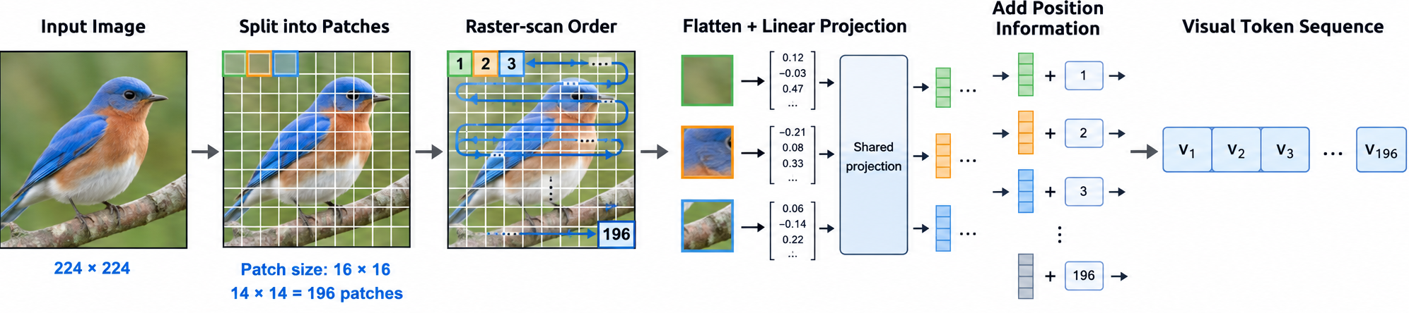
Image Patches Become Visual Tokens
Flatten patch
Linear projection
Visual token
A patch is not necessarily an object or a word; context gives it meaning.
35

Slide 36
Vision Encoder and Projector
Normalized image
Vision Encoder
Visual features
Projector
LLM-sized tokens
Example shapes
[1, 3, 224, 224] → [1, 196, 768] → [1, 196, 4096]
• The vision encoder extracts visual patterns and semantics.
• The projector adjusts the visual feature dimension to match the language model.
36

Slide 37
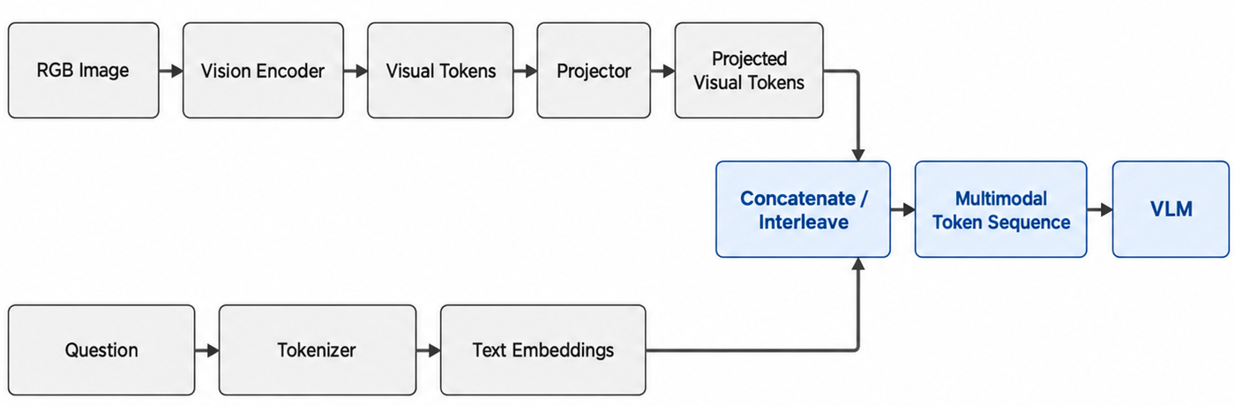
Complete Multimodal Input Pipeline
Visual tokens + text tokens → one multimodal sequence
37

Slide 38
Shape Changing Example
Image tensor
[1, 3, 224, 224] (B,C,H,W)
Vision output
[1, 196, 768] (B, N, D1)
Projected visual tokens
[1, 196, 4096] (B, N, D2)
12 text tokens
[1, 12, 4096] (B, n, D2)
Combined sequence
[1, 208, 4096] (B, N+n, D2)
196 visual tokens + 12 text tokens = 208 total tokens
38

Slide 39
Resolution versus Speed
224 × 224
448 × 448
14 × 14 patches
28 × 28 patches
196 visual tokens
784 visual tokens
• More tokens can preserve more details like small text and objects.
• More tokens consume more computations.
39

Slide 40
Good Multimodal Input = Clear Image + Detailed Prompt
Weak prompt
Stronger prompt
“Describe it.”
“Identify the three main objects.
For each, state position and visible color.
Do not infer information not shown.”
• Use proper image resolution.
• Avoid data augmentations that remove relevant evidence.
• Elaborate a specific question and the output structure.
40

Slide 41
Take-Home Messages
• RGB images are made of three color channels.
• Preprocessing controls both the shape (data augmentation) and numerical distribution (normalization) of visual input.
• Tokenization maps text to IDs; embedding maps IDs to vectors.
• Image patches can be projected into visual token embeddings.
• An MLLM processes visual and textual vectors in a shared sequence.
• Many “model errors” are actually caused by poor input preparation.
Image / Text → Numbers → Tokens → Embeddings → MLLM
42

